Slide 1
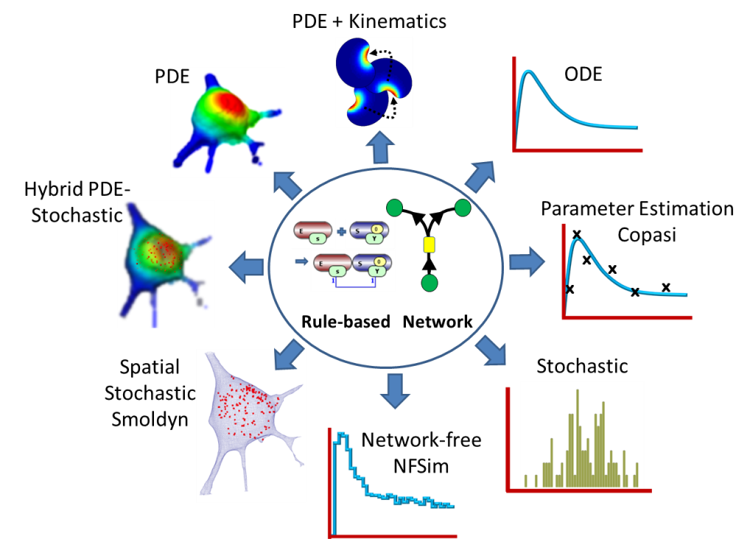

VCell
A modeling environment for the simulation of cellular events. Download at vcell.org.
Virtual Cell is developed by the Center for Cell Analysis and Modeling at the University of Connecticut Health Center. It is funded as a Biomedical Technology Research Resource by the National Institute of General Medical Sciences (NIGMS)

Slide 2
VCell Tutorial
FRAP: Fluorescence Redistribution After Photobleaching
Objective: Create a simple biomodel and spatial (PDE) application to simulate a photobleaching experiment and view the results.

Slide 3
In this tutorial you will:
Gain a basic introduction to the Virtual Cell interface
Create a very simple biomodel with species but no reactions
Create a spatial deterministic (PDE) application of a model using analytic equations to create a simple geometry
Use Boolean expressions to define initial concentrations that are non-uniform
View and analyze results of a spatial simulation

Slide 4
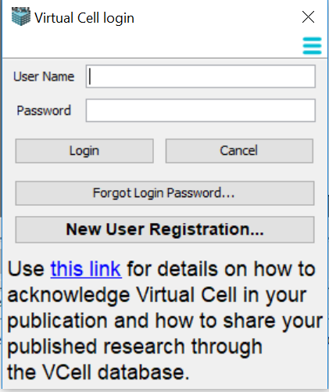
Your first time opening VCell
You need to register as a New User if you want to run simulations on the VCell compute resources, or use the VCell database to store models that can be shared with collaborators.

Slide 5
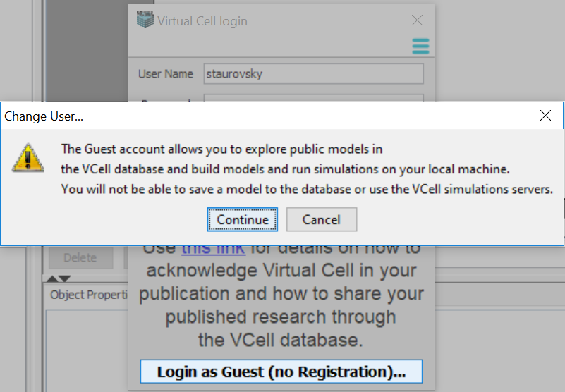
Your first time opening VCell Guest Login Option

Slide 6
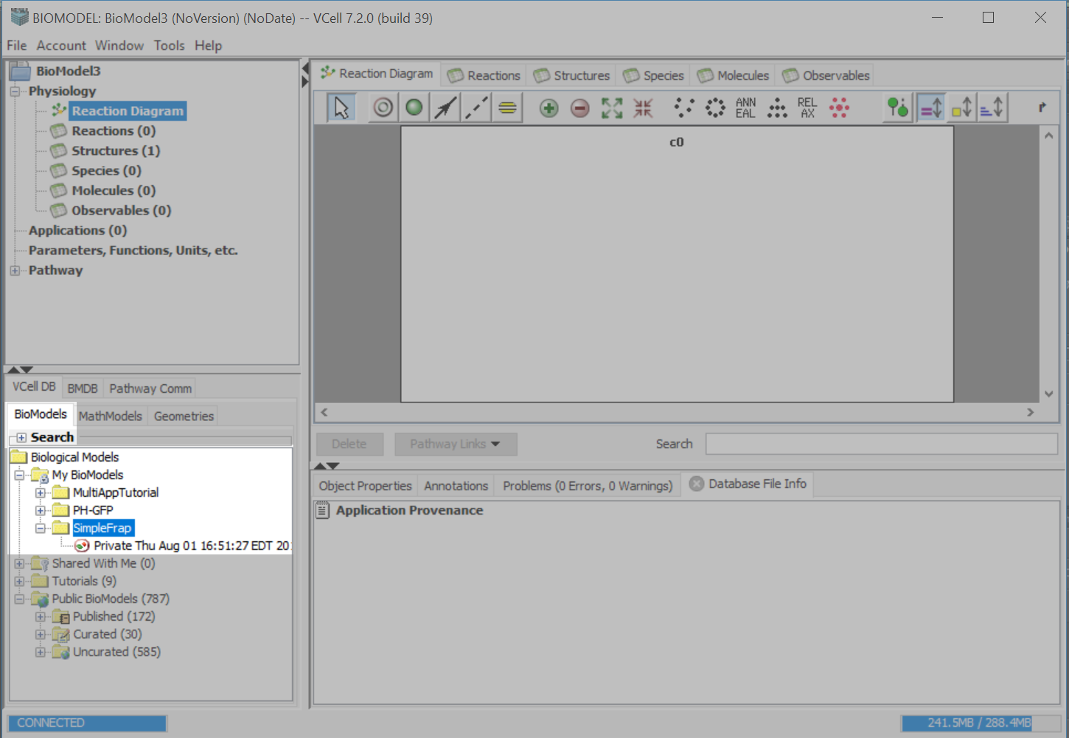
To re-open a model, click on the folder that the model was saved in and double-click on the model.

Slide 7
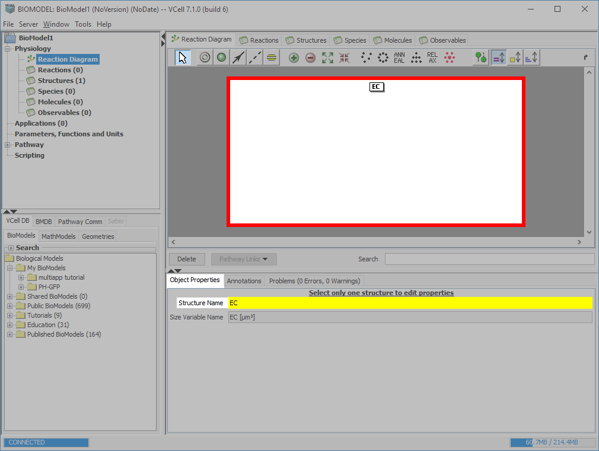
Starting a new model
Choose the “Select” tool and select the compartment. On the “Object Properties” tab, type “EC” in the “Structure Name” text field and press Enter to accept the entry.

Slide 8
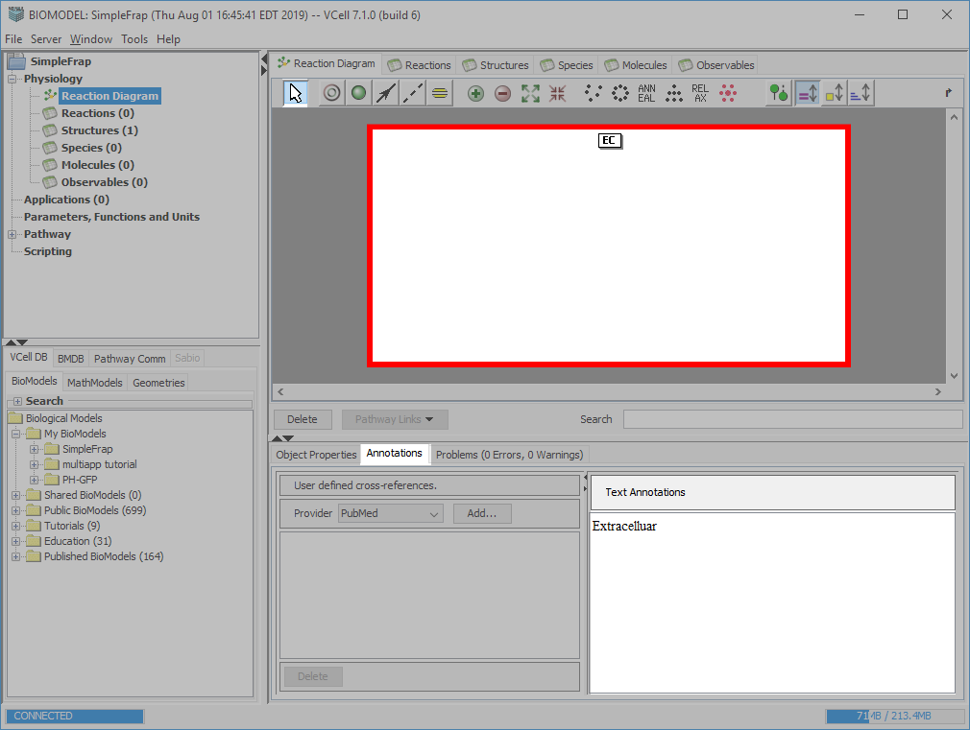
Select the “Annotations” tab and type “Extracellular” in the “Text Annotations” text field.

Slide 9
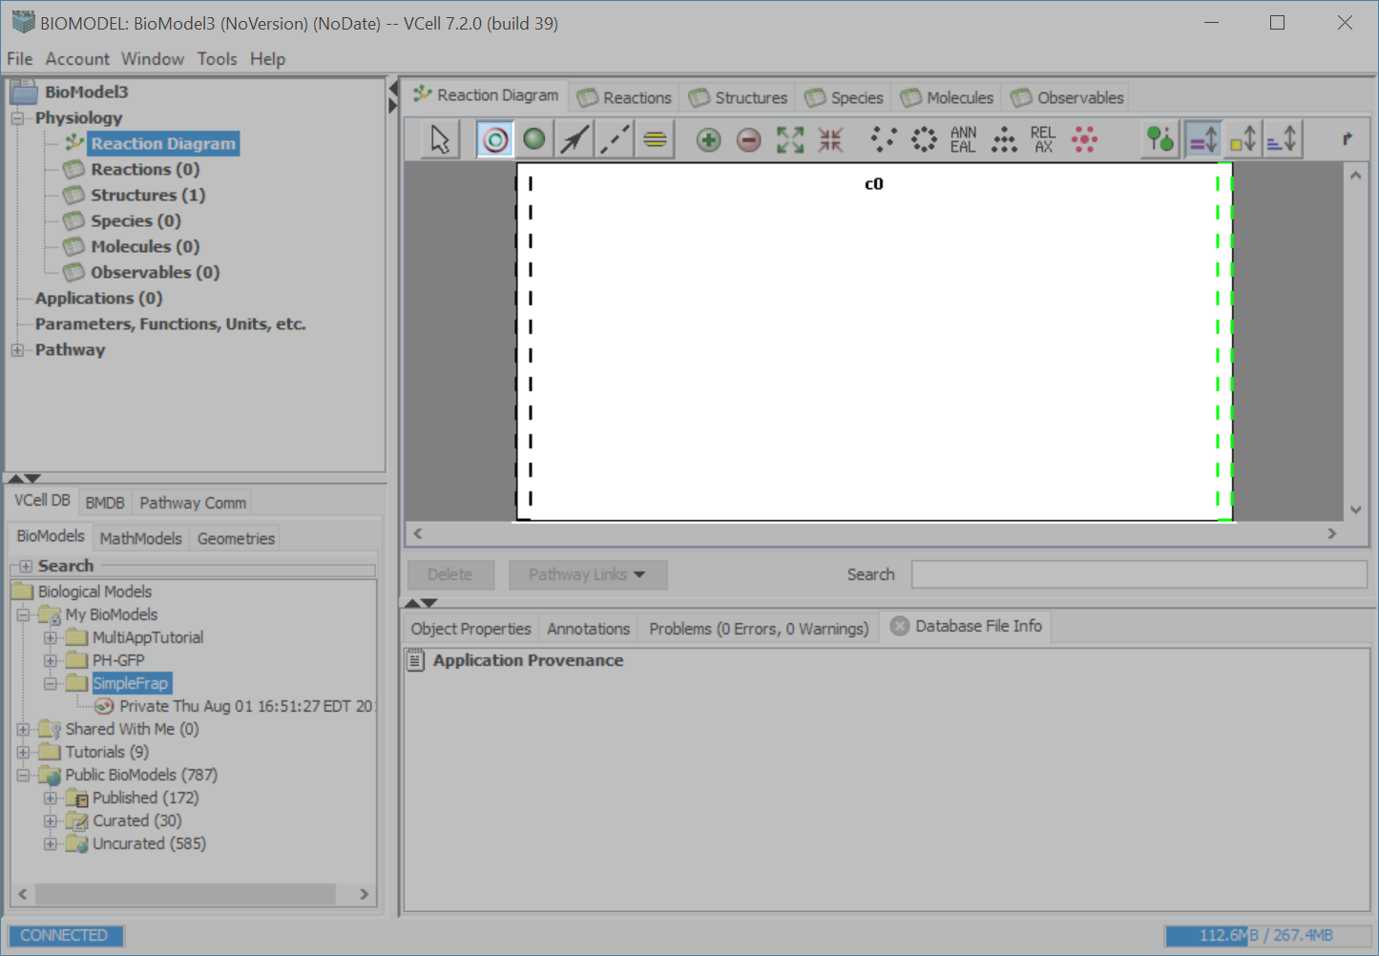
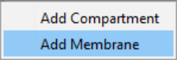
Select the compartment tool, and hover over the dotted black lines so that they turn green. Click on the lines to access the “Add Membrane” menu, select “Add Membrane”.

Slide 10
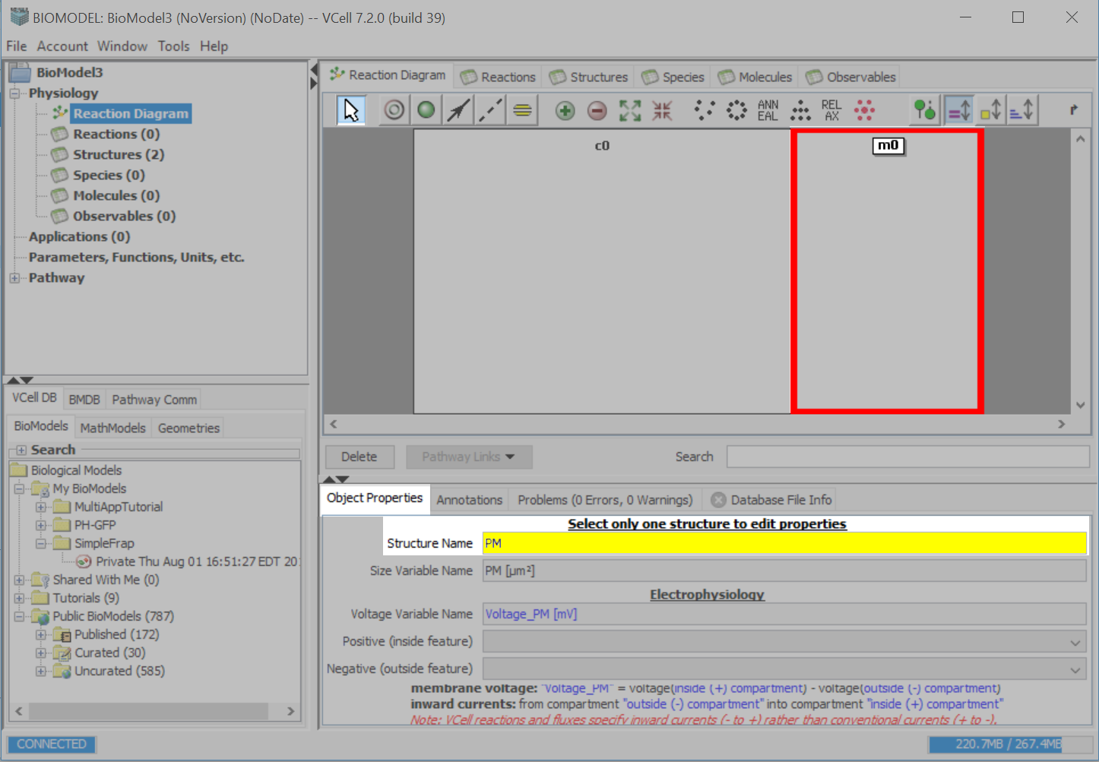
Click on the label “m0”.
Select the “Select Tool”.
On the Object Properties tab, type “PM”, for Plasma Membrane,
in the Structure Name text field.

Slide 11
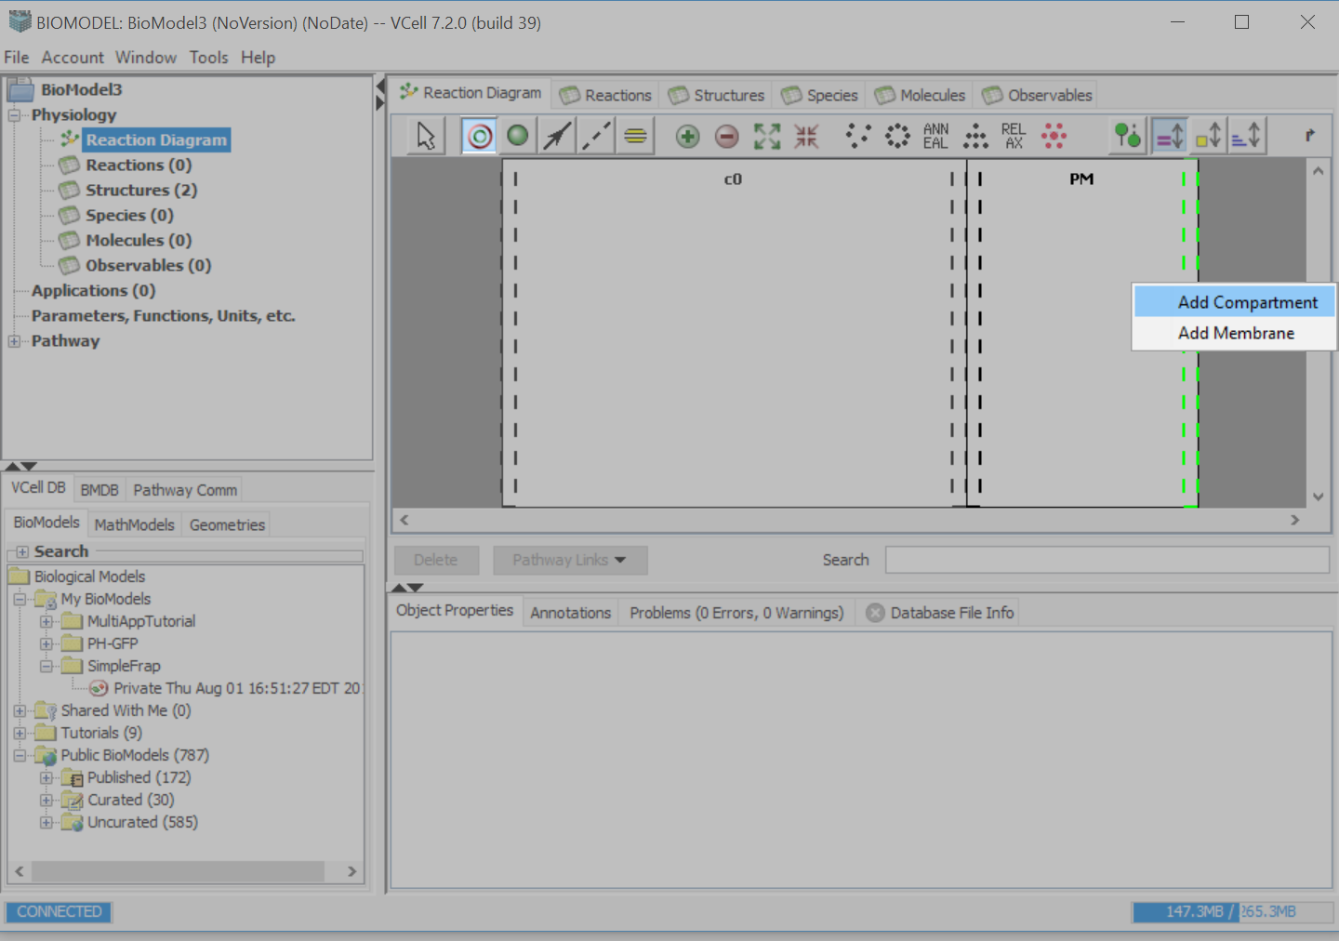
Select the compartment tool, and to the right of PM, hover on the dotted black lines so that they turn green and click “Add Compartment”.

Slide 12
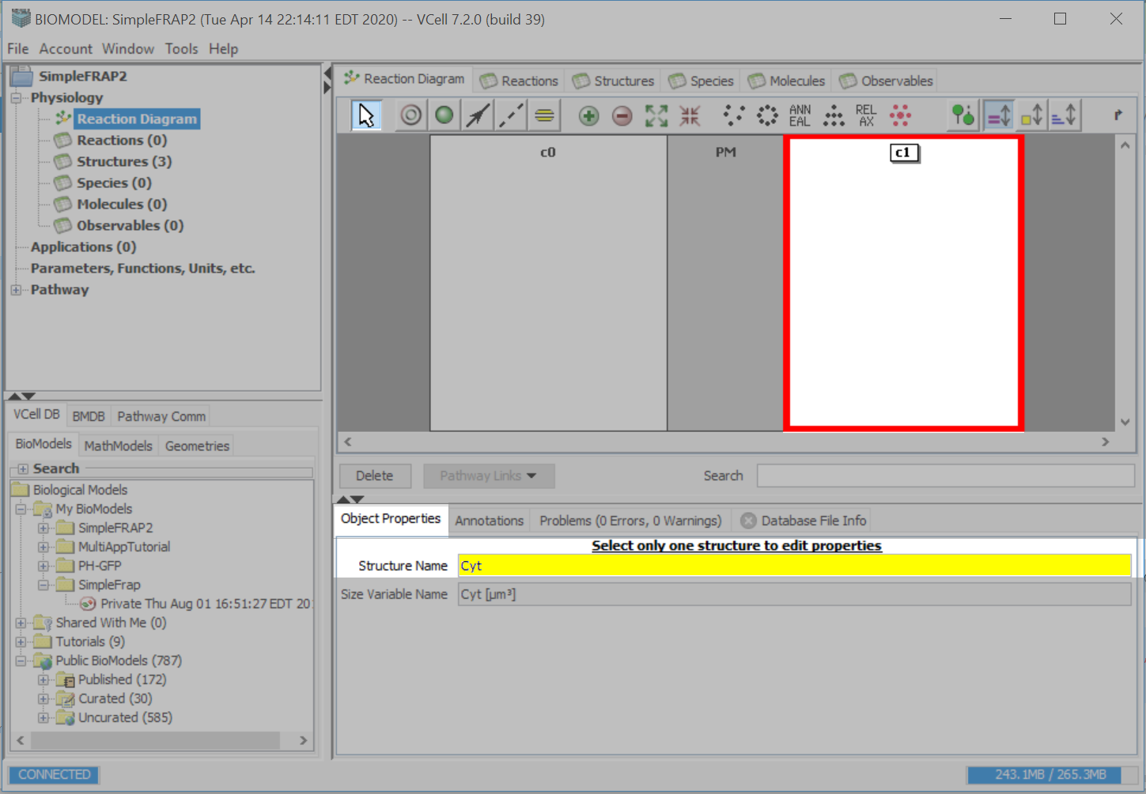
Click on the select tool and then click on the newest compartment. On the Object Properties tab, enter “Cyt”, for cytosol, in the Structure Name text field.

Slide 13
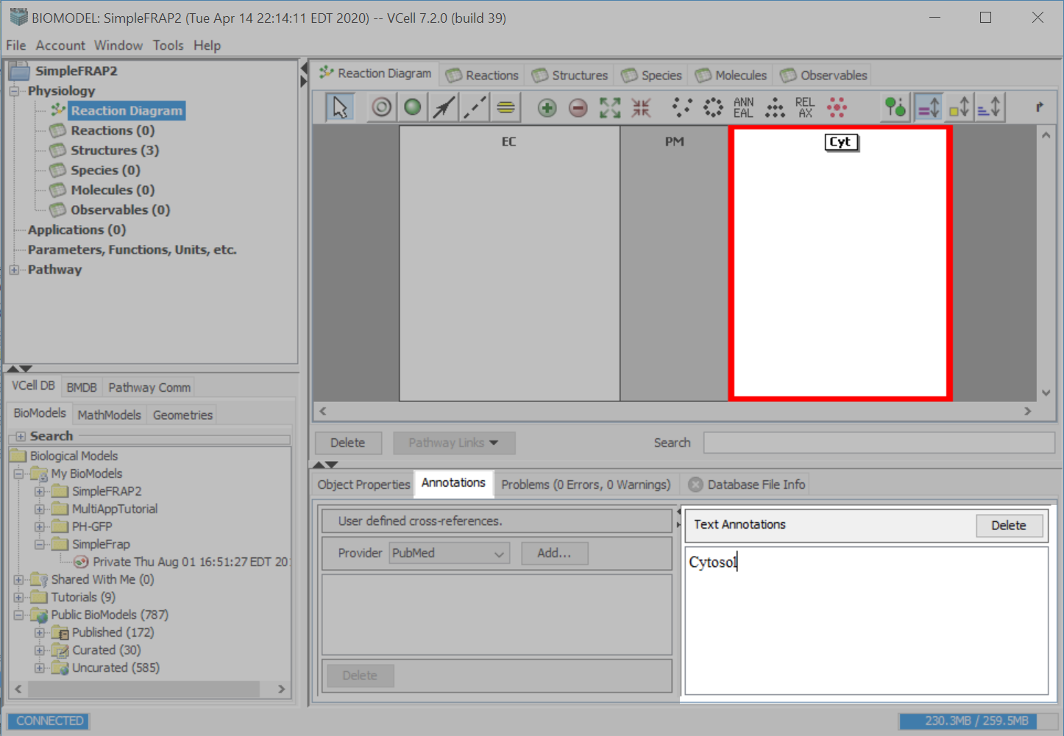
Select the “Annotations” tab and type “Cytosol” in the “Text Annotations” text field.

Slide 14
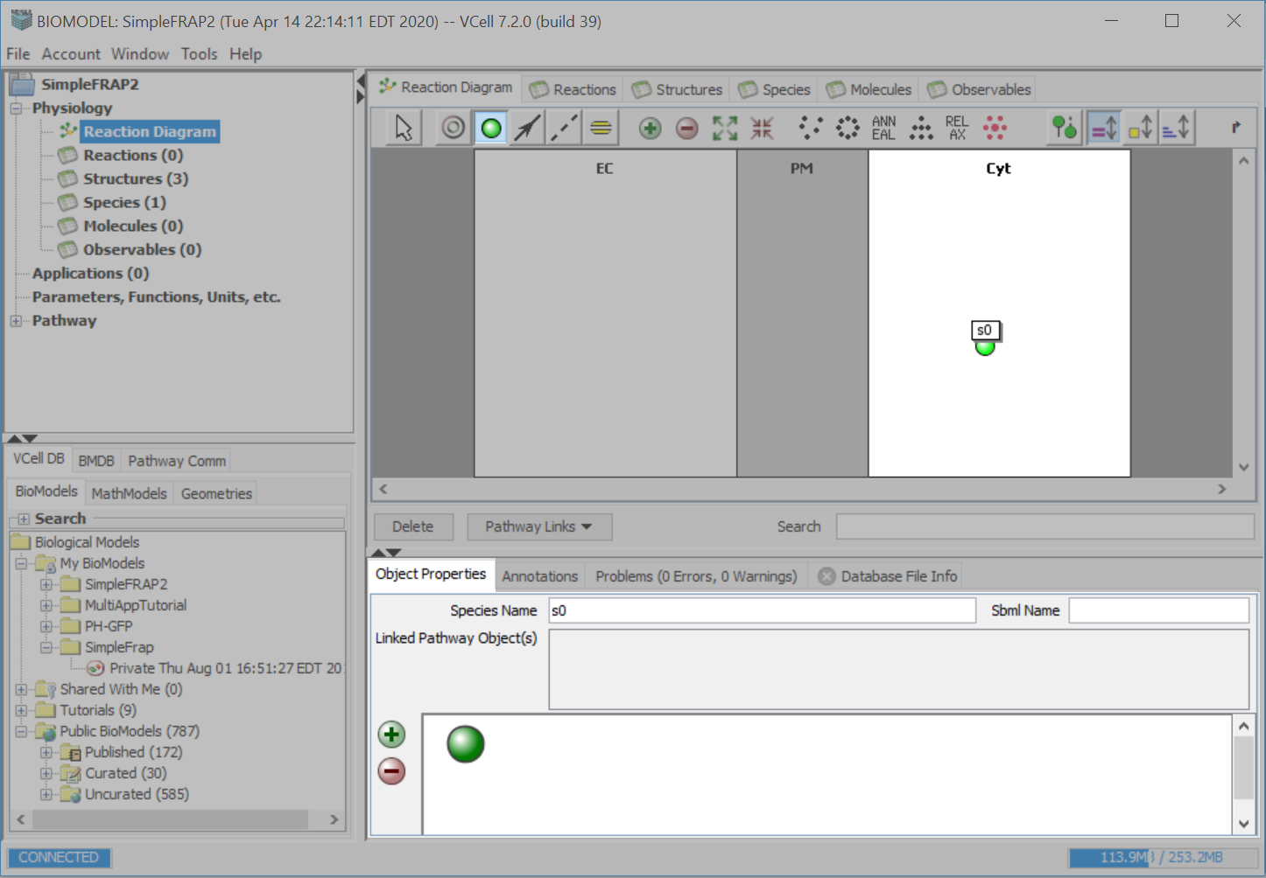
Select the species tool. Click on a point within the “Cyt” compartment and click to create a new species.

Slide 15
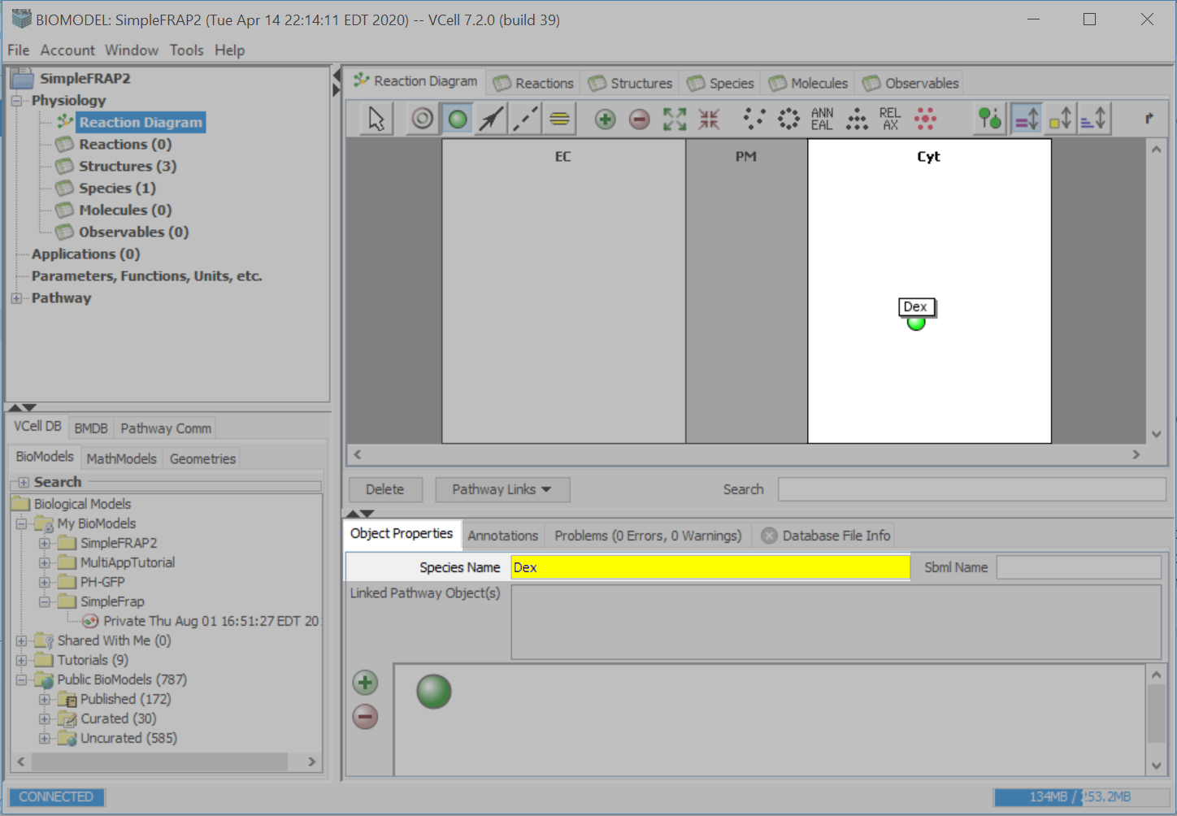
On the Object Properties tab, enter “Dex” in the Species Name text field.

Slide 16
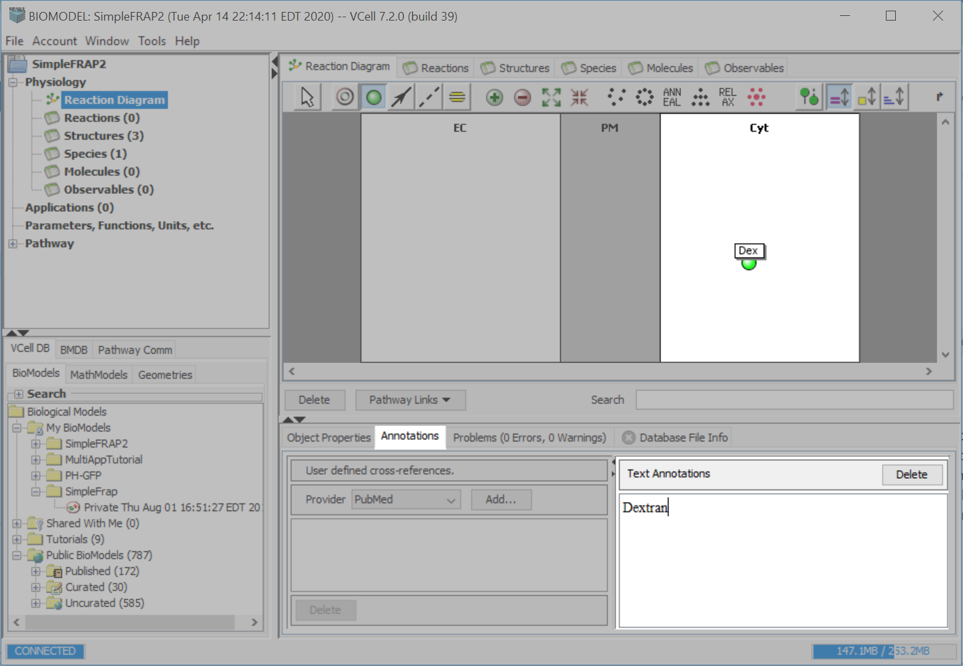
Select the “Annotations” tab and type “Dextran” in the “Text Annotations” text field.

Slide 17
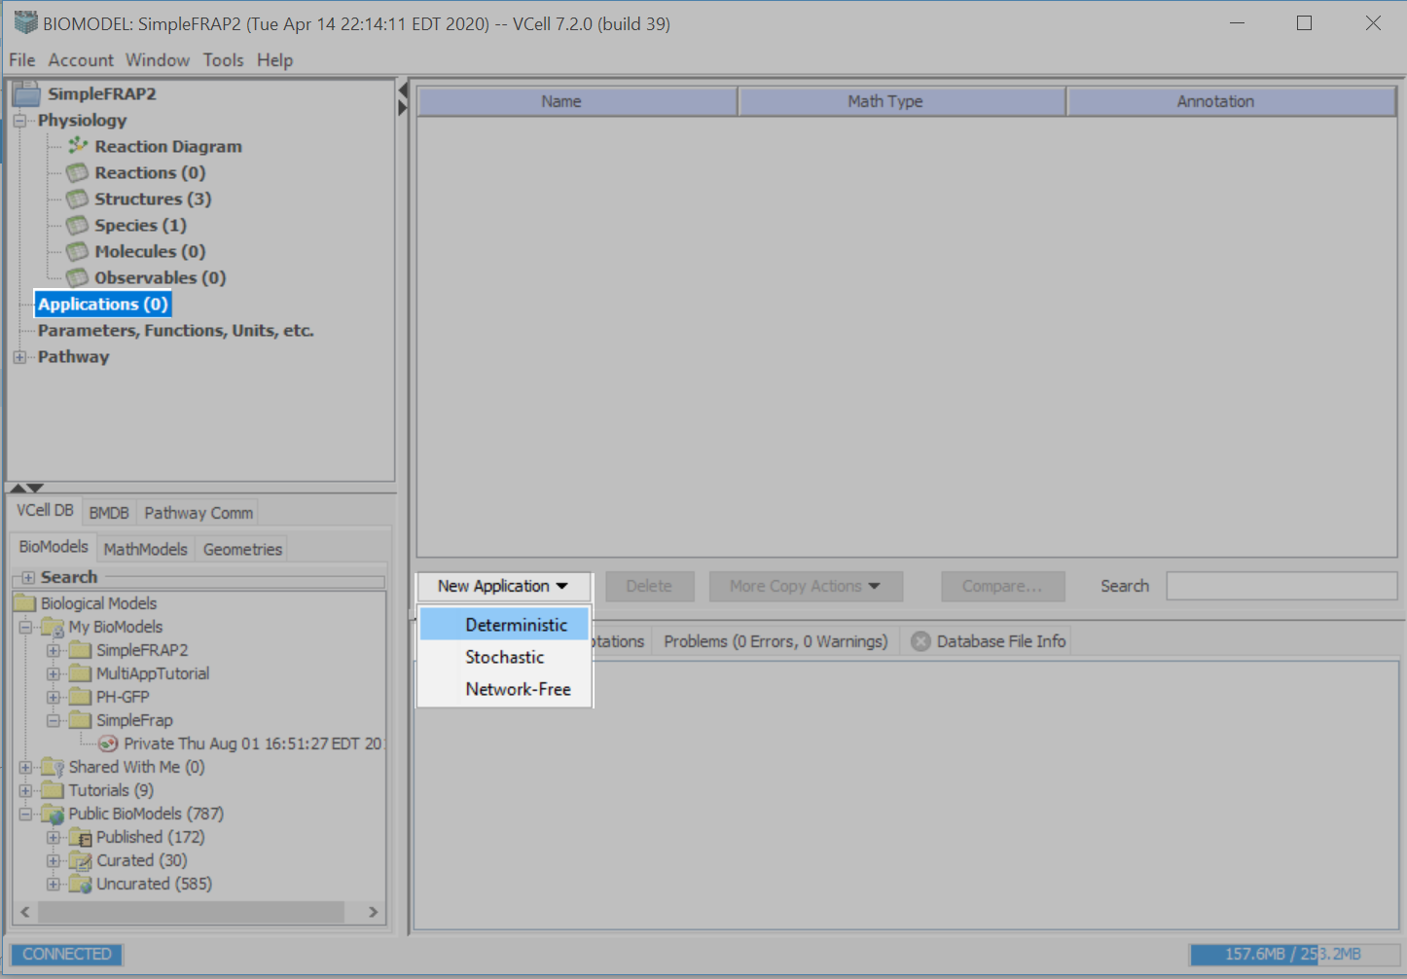
Go to the Application workspace using the left menu tree. Select “New Application” and choose “Deterministic” from the dropdown menu.

Slide 18
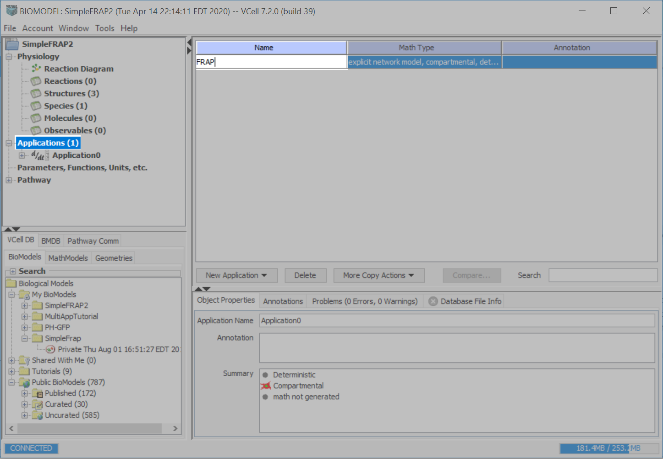
Double click on the Name text field and rename the application as “FRAP”. Press “Enter” on your keyboard to accept the entry.

Slide 19
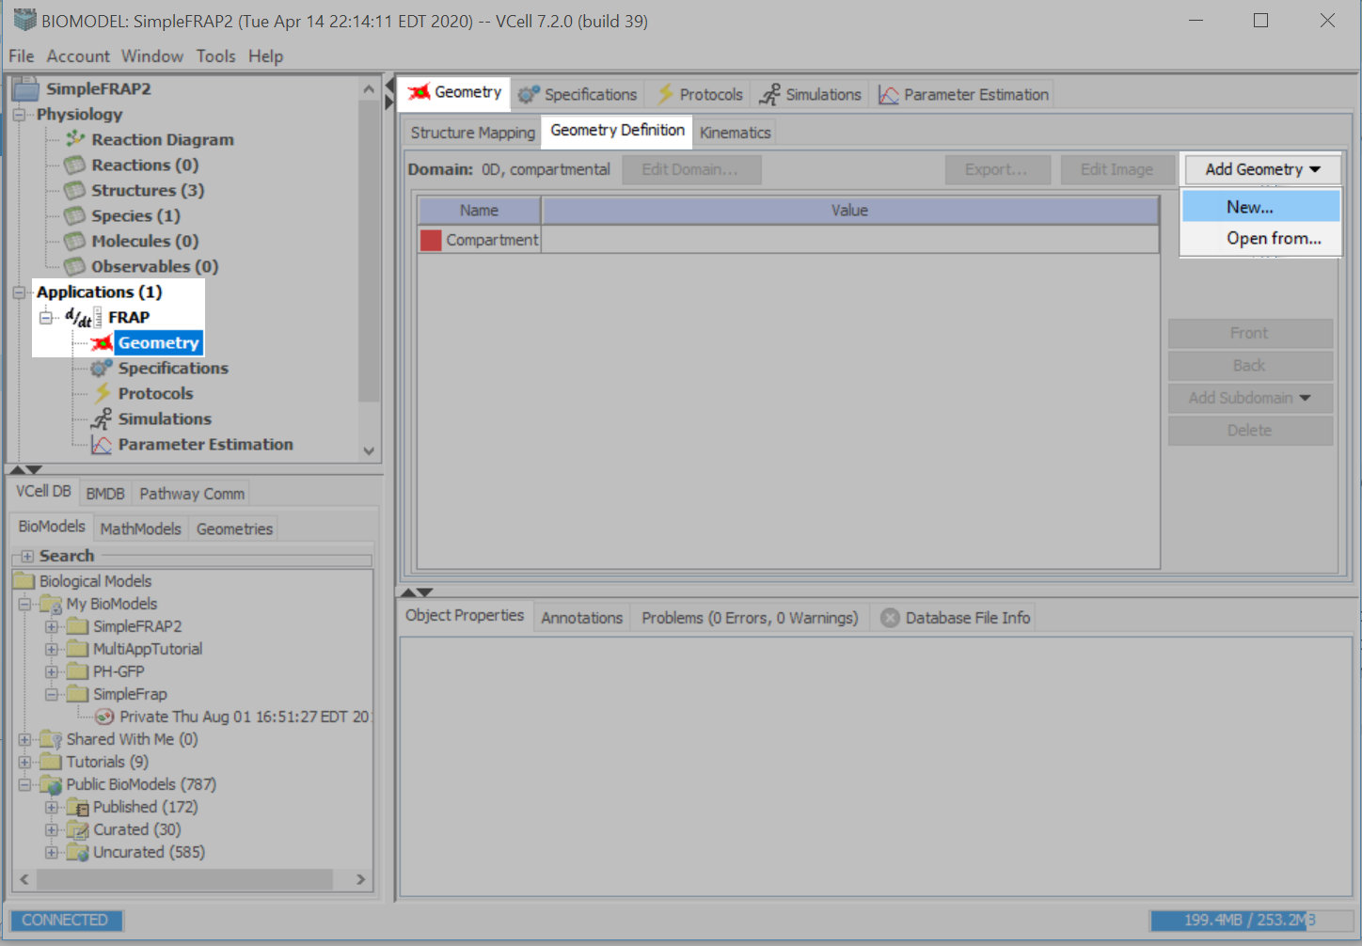
Expand the menu tree under Applications>FRAP>Geometry. Select the “Geometry” application and then “Geometry Definition” on the Geometry tab. Go to “Add Geometry” and select “New”.

Slide 20
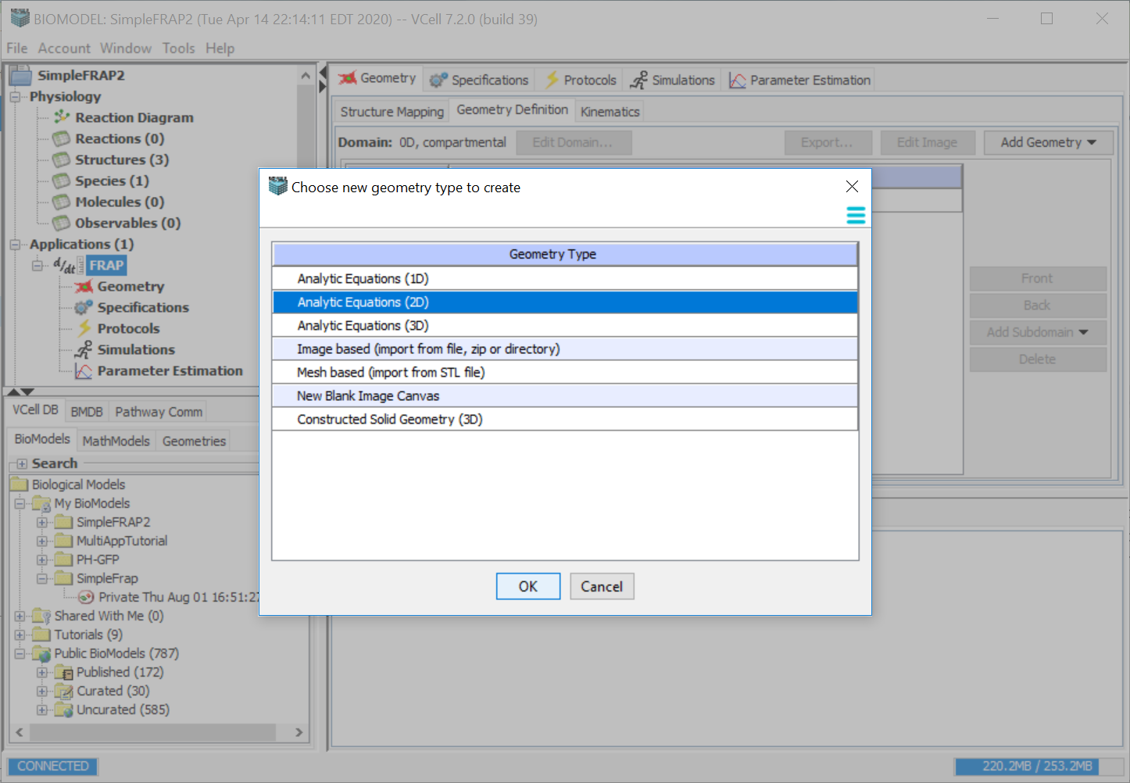
Click “Analytic Equations (2D)”, then press “OK”.

Slide 21
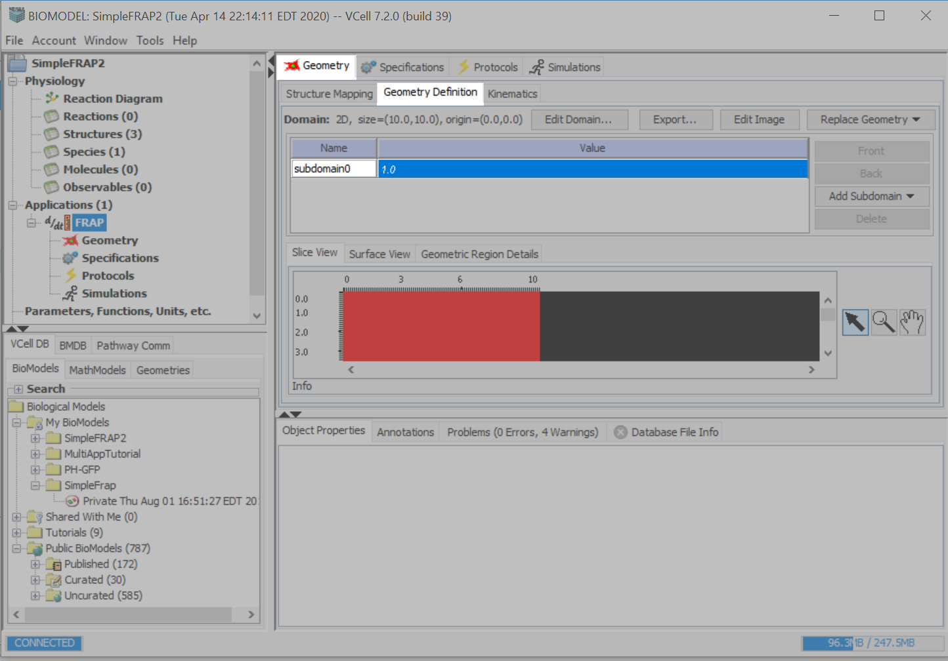
Double click on “Subdomain0” and type in “EC”. Press “Enter” on your keyboard to accept the entry.

Slide 22
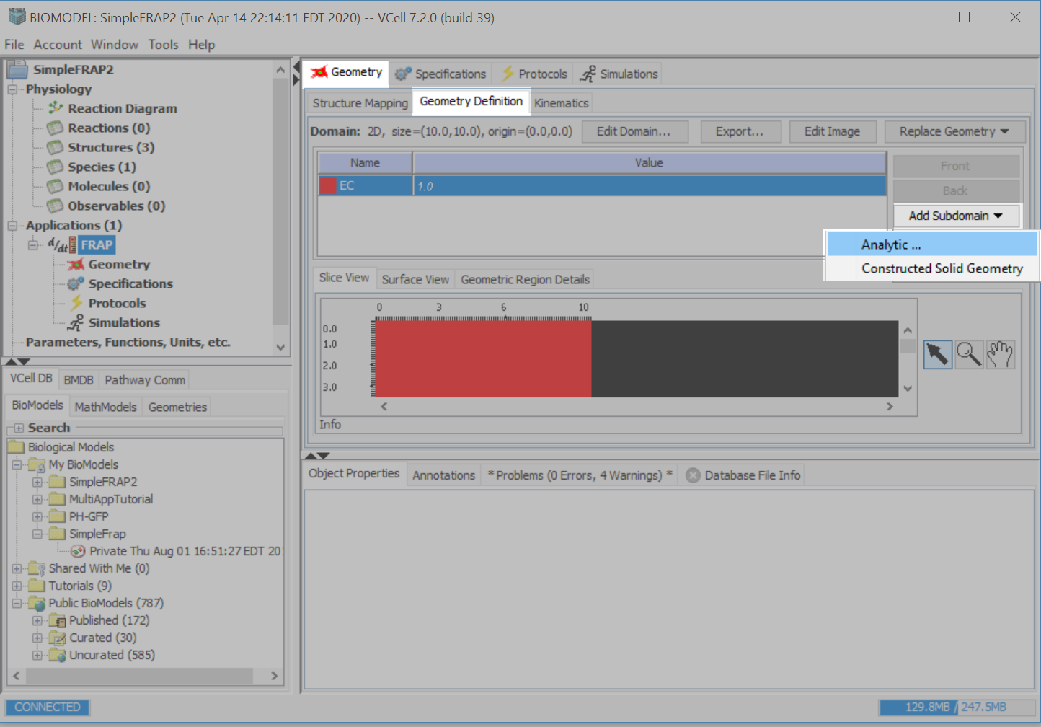
Click “Add Subdomain”, select “Analytic”.

Slide 23
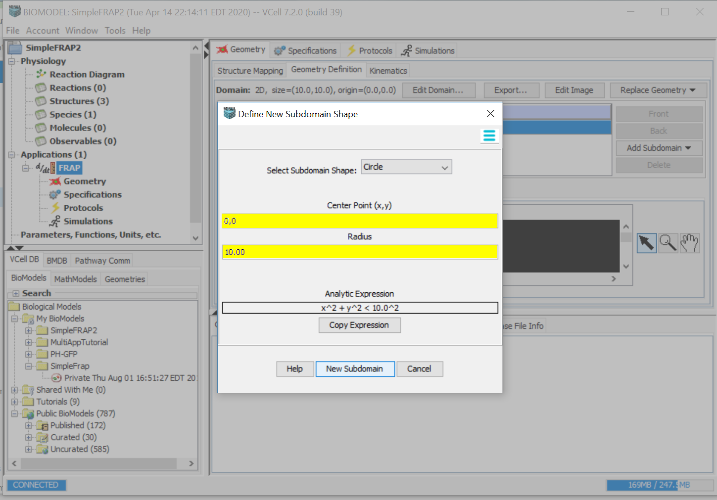
Select “Circle” from the drop down menu.
Type in “0,0” for the Center Point.
Type in “10” for the radius.
Click “Add New Subdomain”.

Slide 24
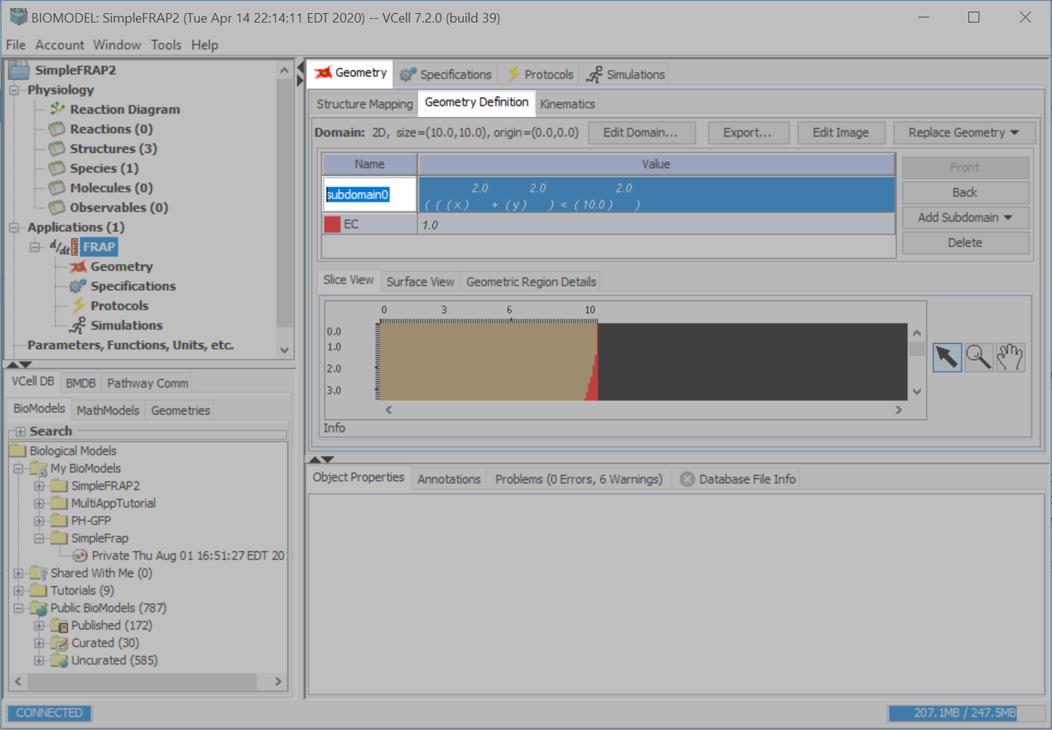
Double click on the name box of the new subdomain and type in “Cyt”, press “Enter”.

Slide 25
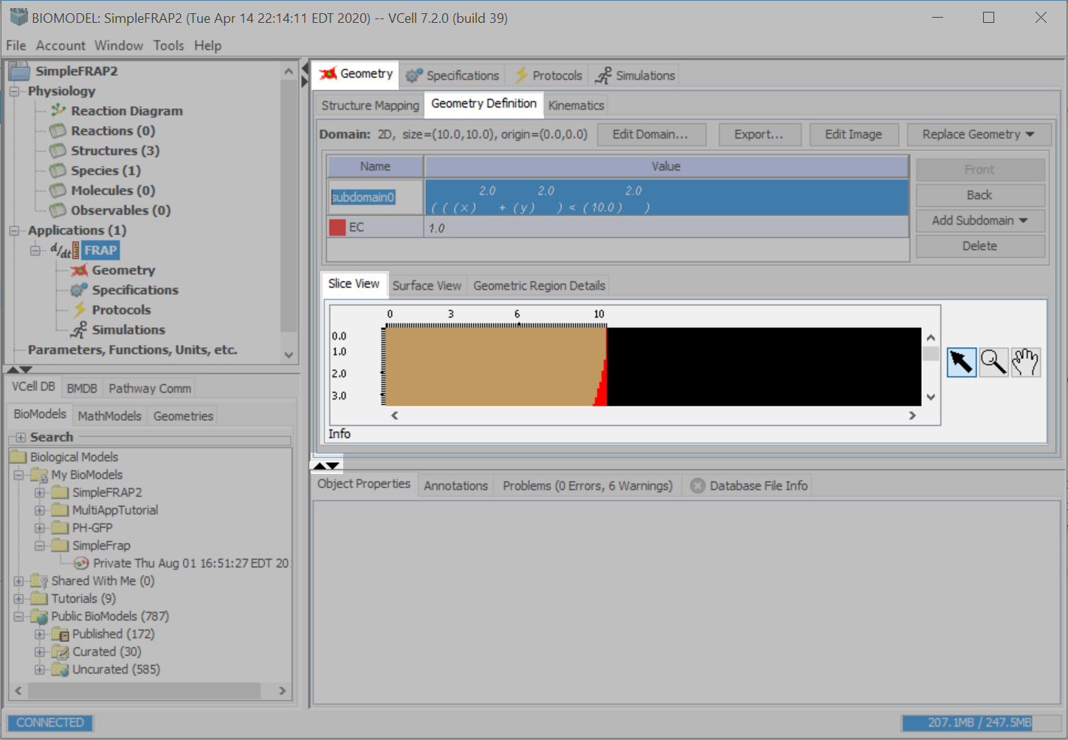
Click the black down arrow to enlarge the Slice View window.

Slide 26
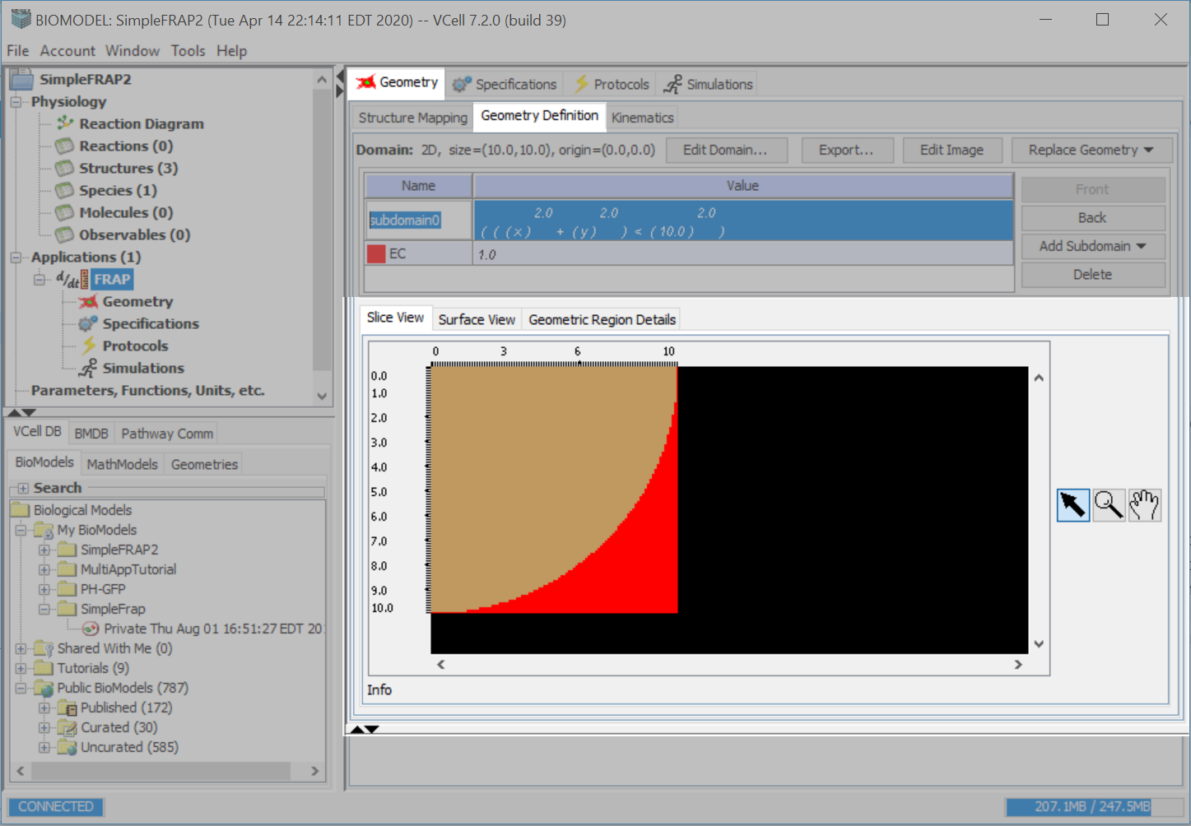
Click the black up arrow to minimize the Slice View window.

Slide 27
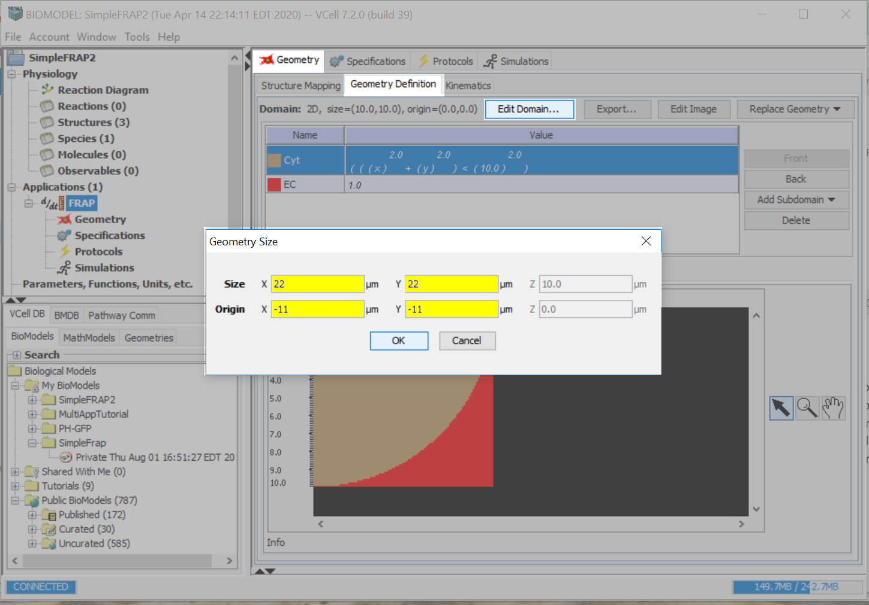
Select “Edit Domain”
Enter the following values for:
“Size”: 22 for X and Y
“Origin”: -11 for X and Y.
Press “OK” to accept your entries.

Slide 28
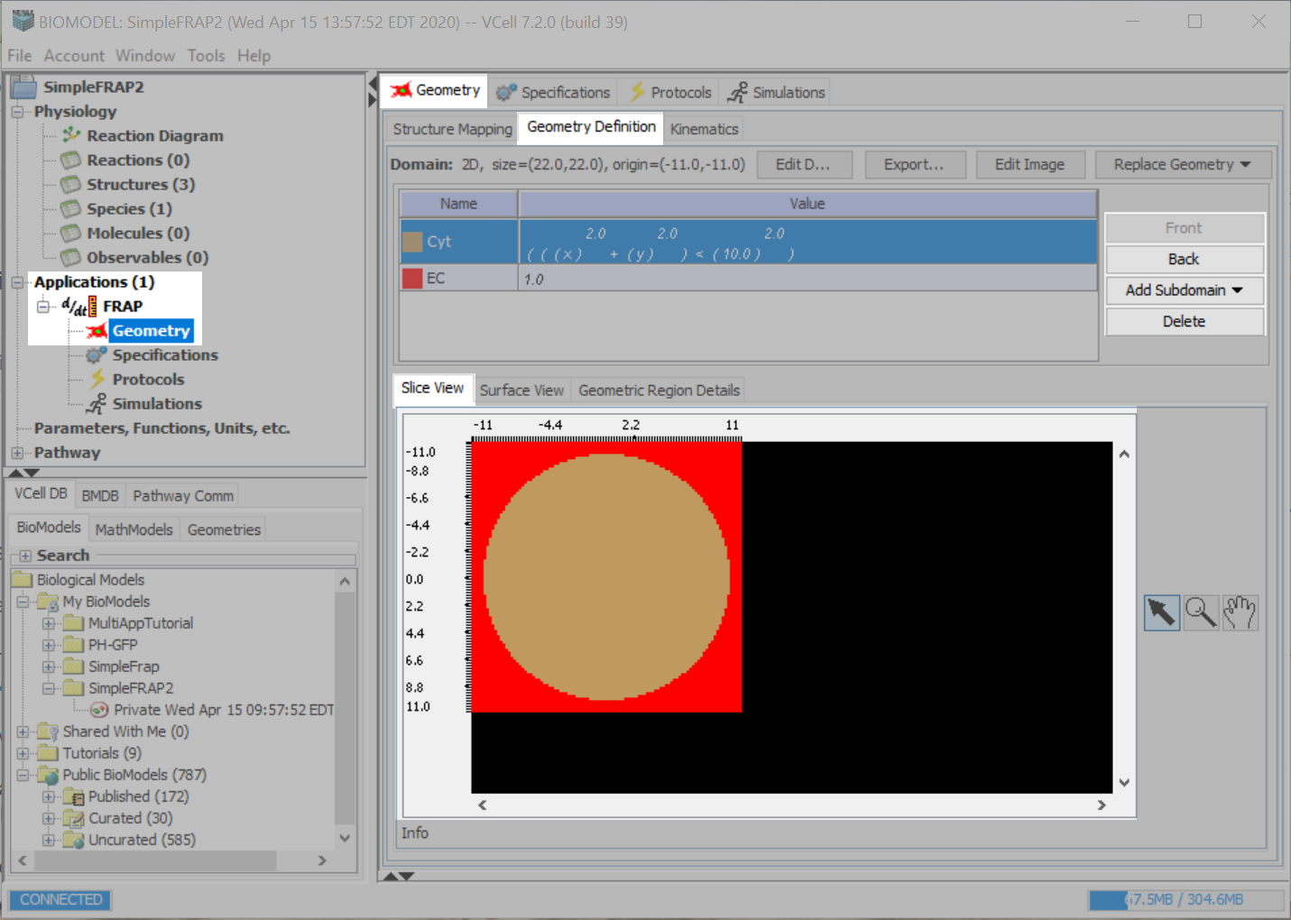
Click “Front” or “Back” to rearrange the geometry order.
The order determines which subdomain a point in space belongs to; the front layer “hides” layers below.
Your geometry in the “Slice View” option should be a circle of radius 10 µm, inside a 22 X 22 µm square.

Slide 29
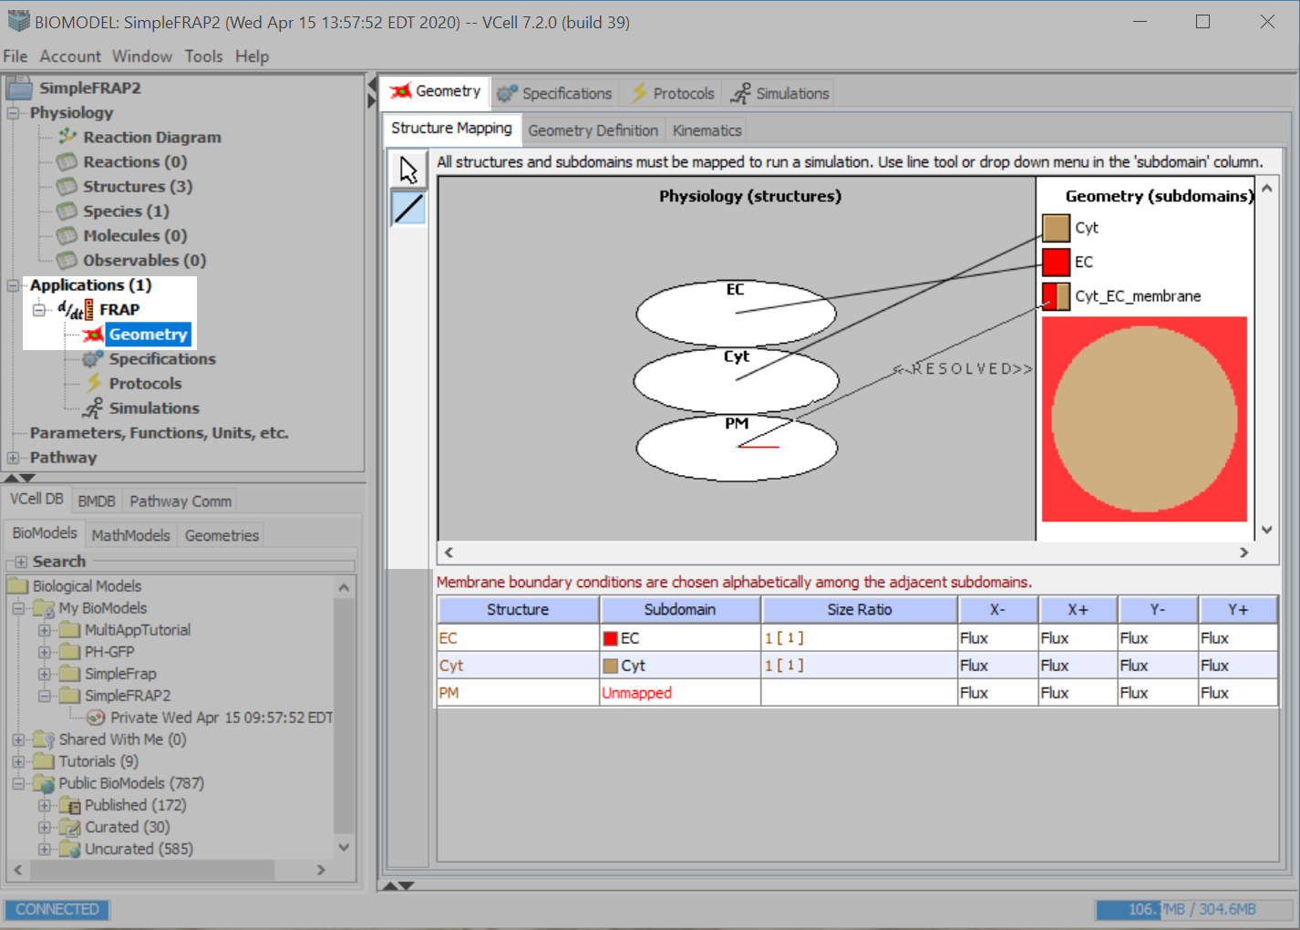
Select the “Structure Mapping” tab, on the ”Geometry” tab.
Use the Line tool to drag a line from the structures to their corresponding subdomains. You must select the line tool each time you create a new mapping.
Be sure your mapping says
“Resolved” to complete the mapping.

Slide 30
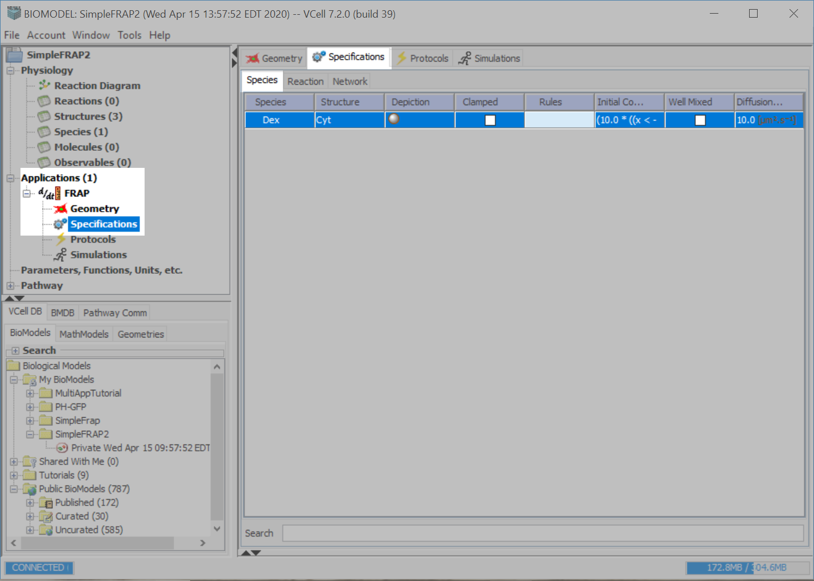
Click the “Specifications” tab, and then the “Species” tab.
Double click on the “Initial Condition” box for Dex and type in:
“(10.0*((x<-5.0)||(x>5.0)||(y<-5.0)||(y>5.0)))”.
Press “Enter” on your keyboard to accept your entry.
This Boolean expression for the initial concentration evaluates to
10 µM everywhere except from x = -5 to 5 and from y = -5 to 5,
where the expression evaluates to 0.

Slide 31
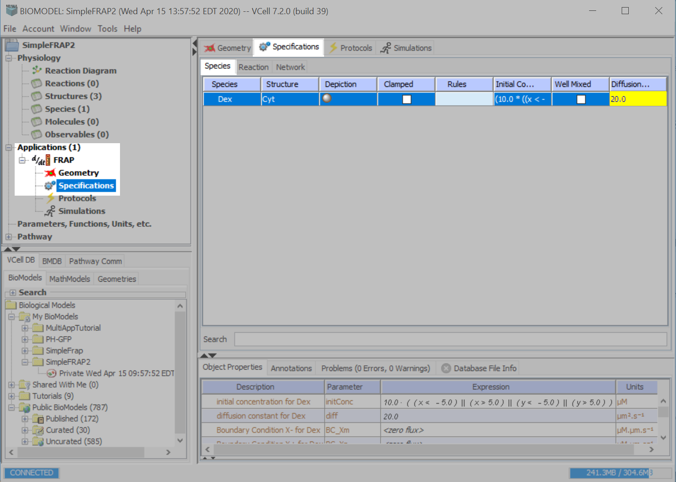
Type “20” in the “Diffusion Constant” text field.
Press “Enter” to accept your entry.

Slide 32
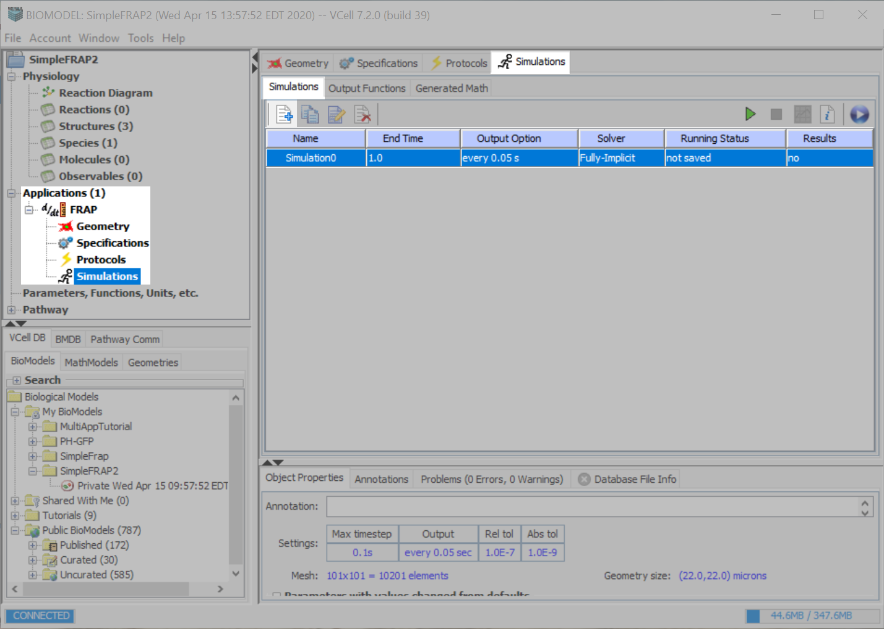
Click “Simulations” and the New Simulation icon.
Double click on “Simulation0” and type in “FRAP”. Press “Enter” to accept your entry.

Slide 33
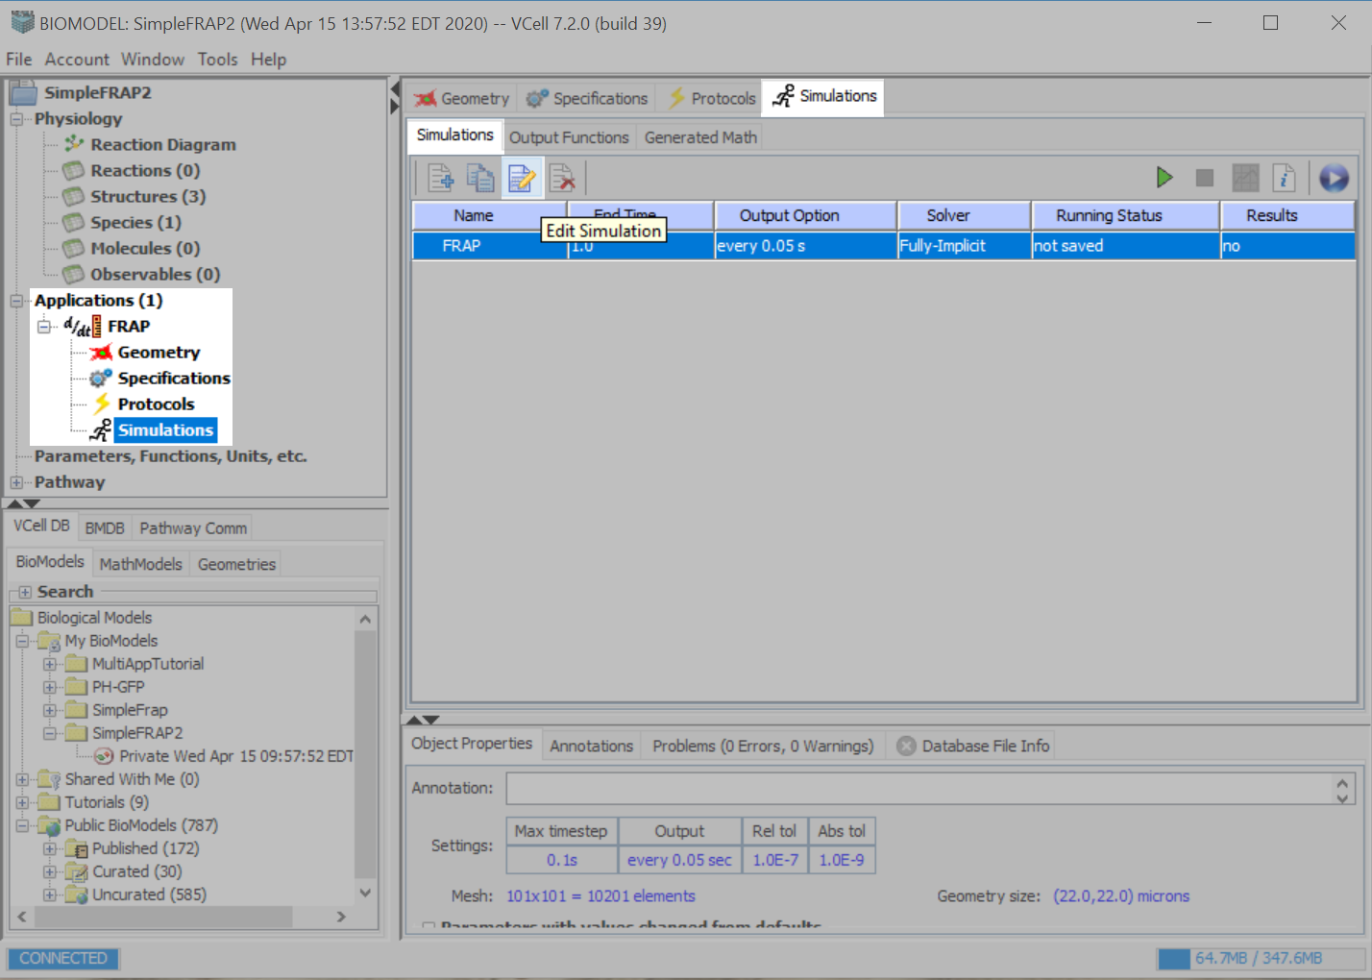
Click the “Edit Simulation” icon.

Slide 34
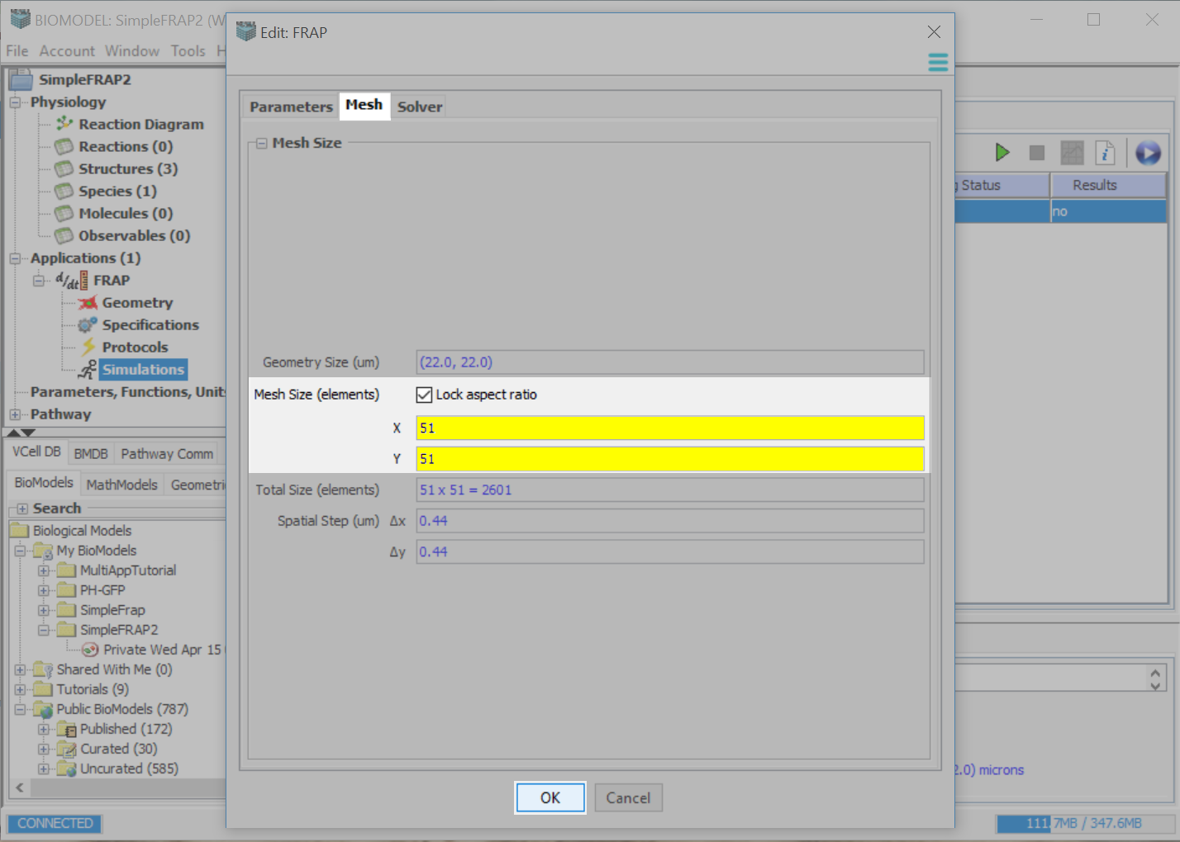
Select the “Mesh” tab.
Leave “Lock aspect ratio” option checked. Type in “51” for X “Mesh Size”.
Next, select the “Solver” tab.

Slide 35
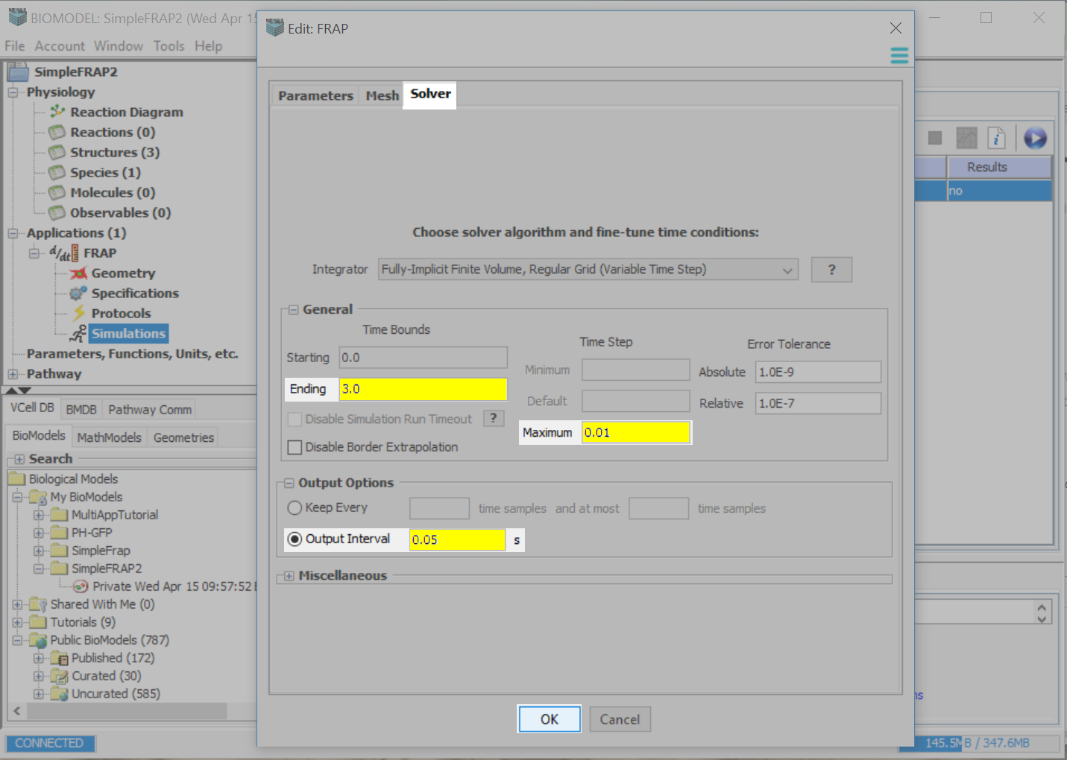
Type in the following parameters:
Ending Time Bound: 3.0
Maximum Time Step: .01
Output Interval: .05
Click “OK”.

Slide 36
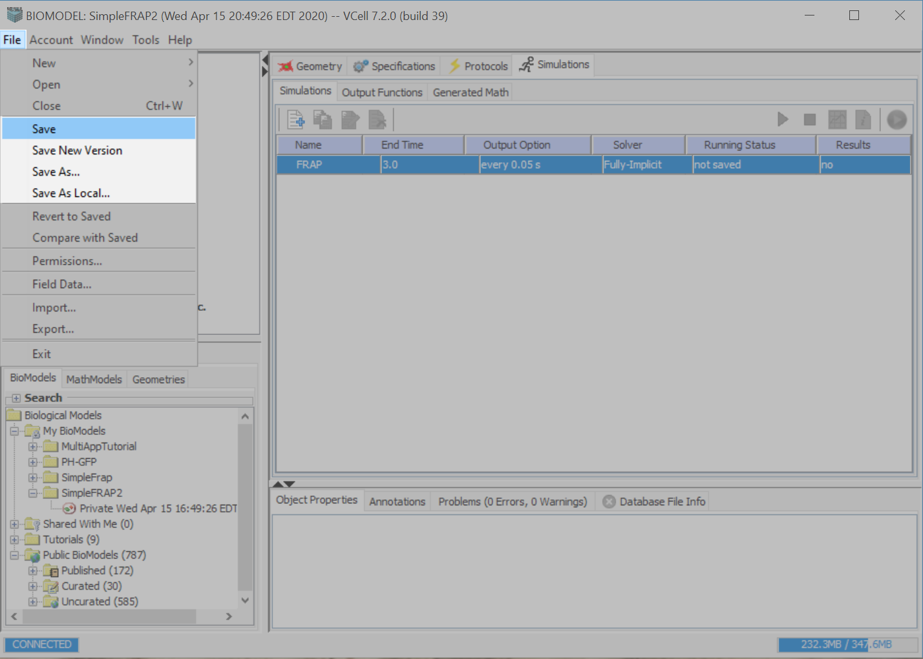
Prior to running your simulation, first save your model.
Go to “File”, and then to one of the save options.

Slide 37
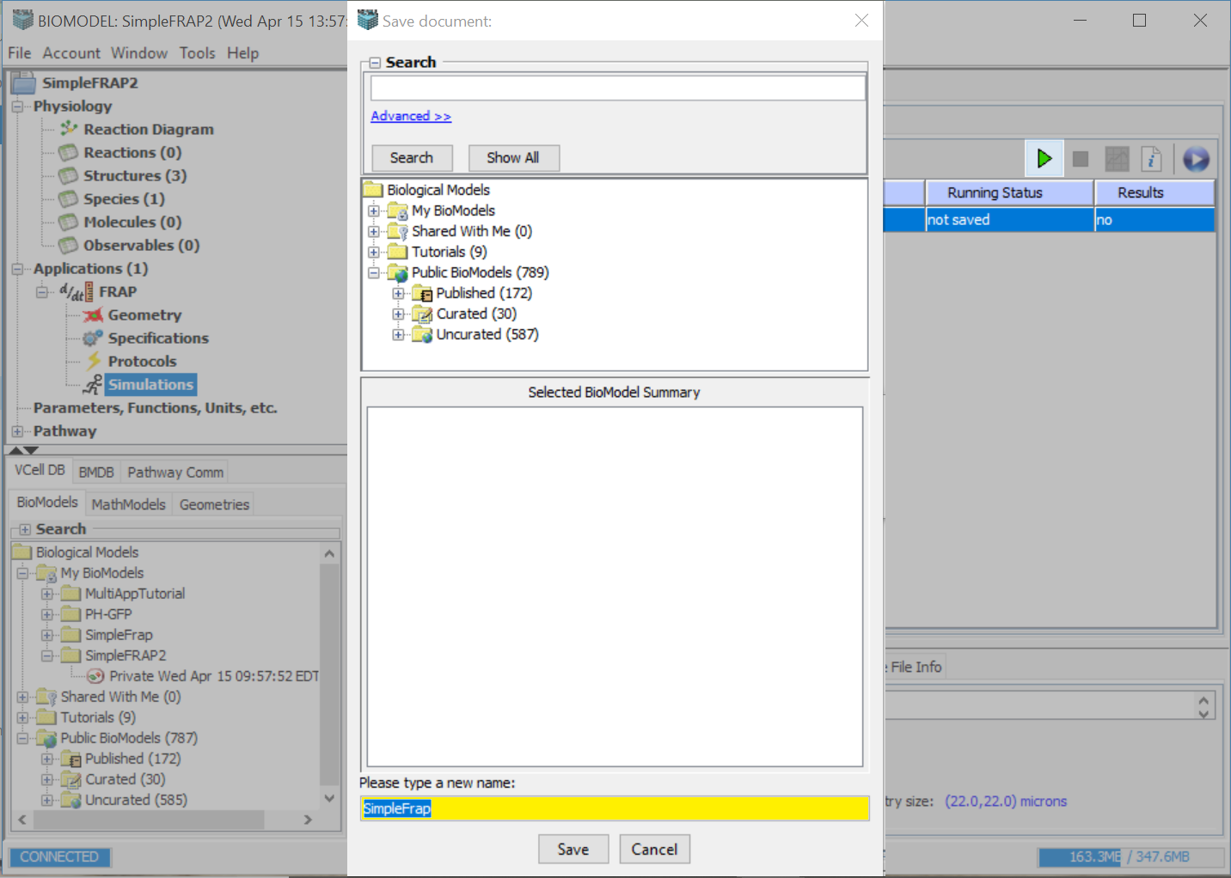
Type in a name for your FRAP model, then click the “Save” button.

Slide 38
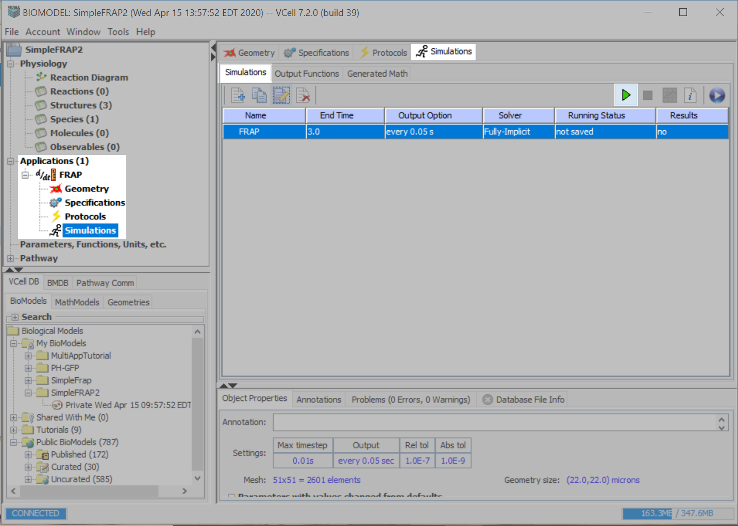
Press the green “Play” button to run the simulation.

Slide 39
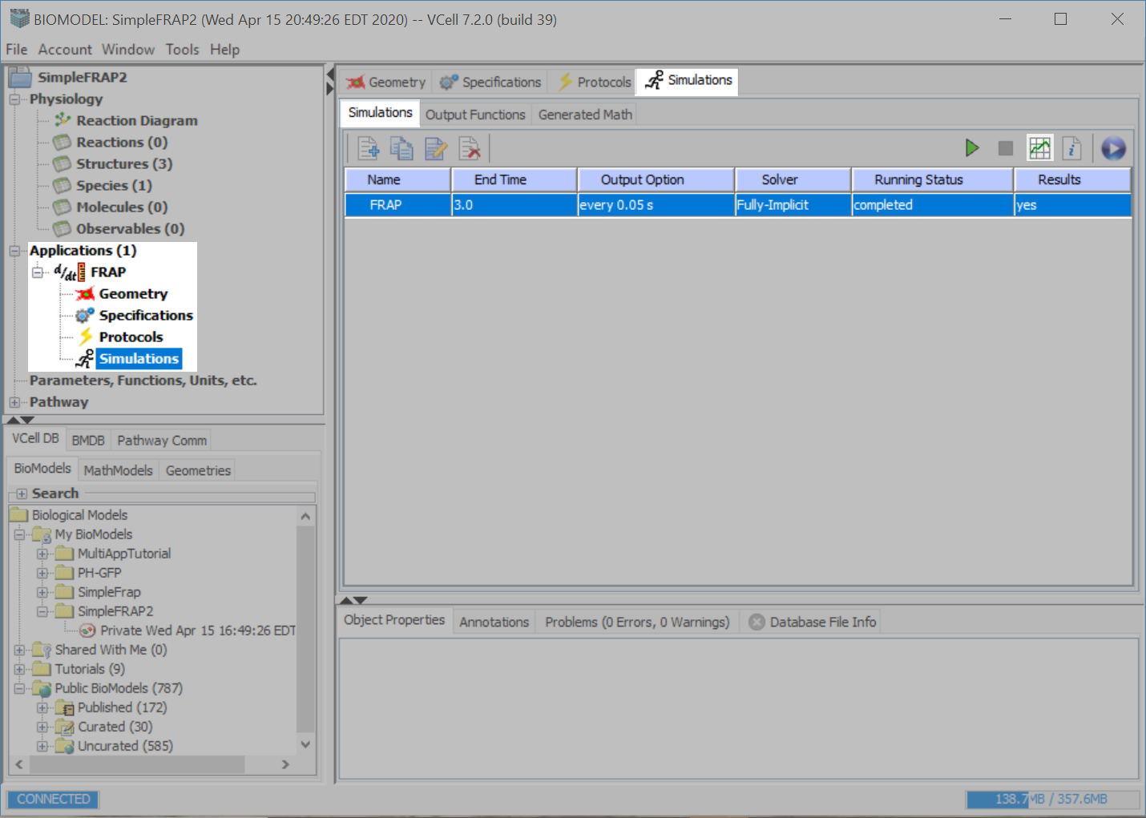
You can view the status of your simulation, under “Running Status”. You can view the results as soon as there are time points saved to the database.
In order to see your results, make sure the simulation is selected, and then press the “Results” icon.

Slide 40
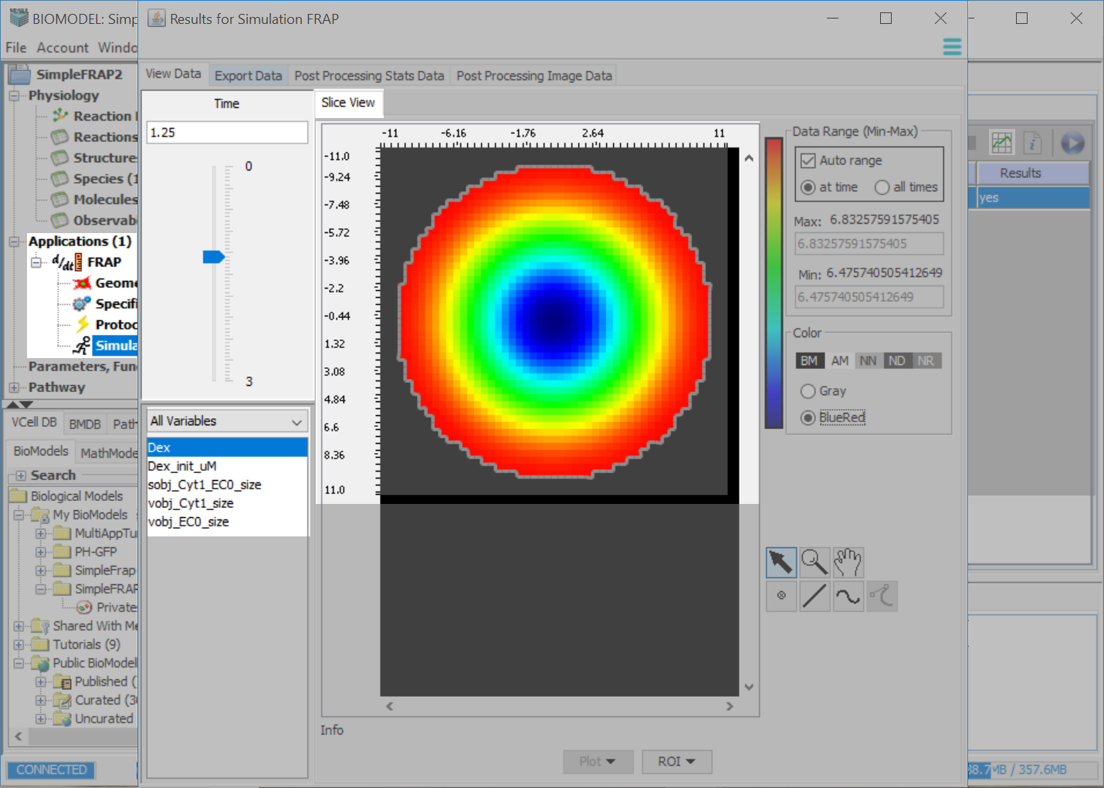
To change the time frame being viewed, either type in a value under “Time” or hold down and drag the slider.
Select a variable to view the results.

Slide 41
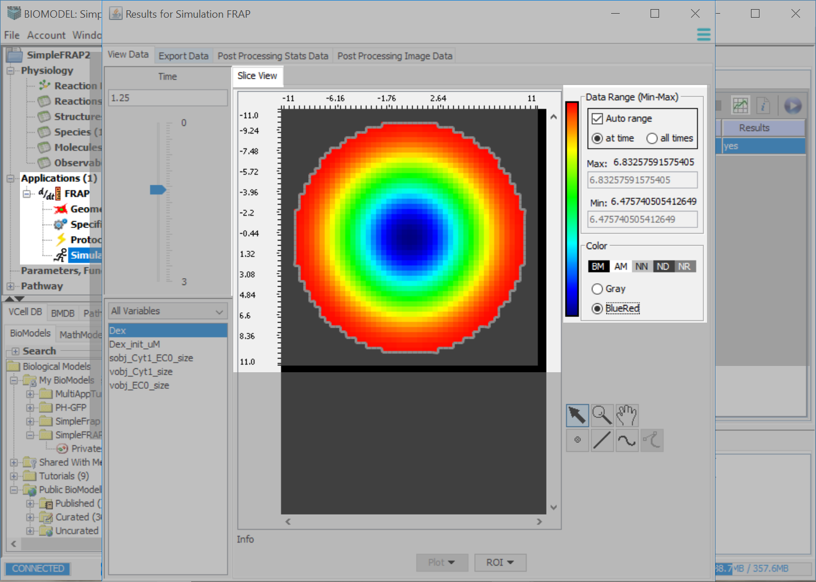
The maximum and minimum values correspond to the colors shown as either Gray or BlueRed color scale.

Slide 42
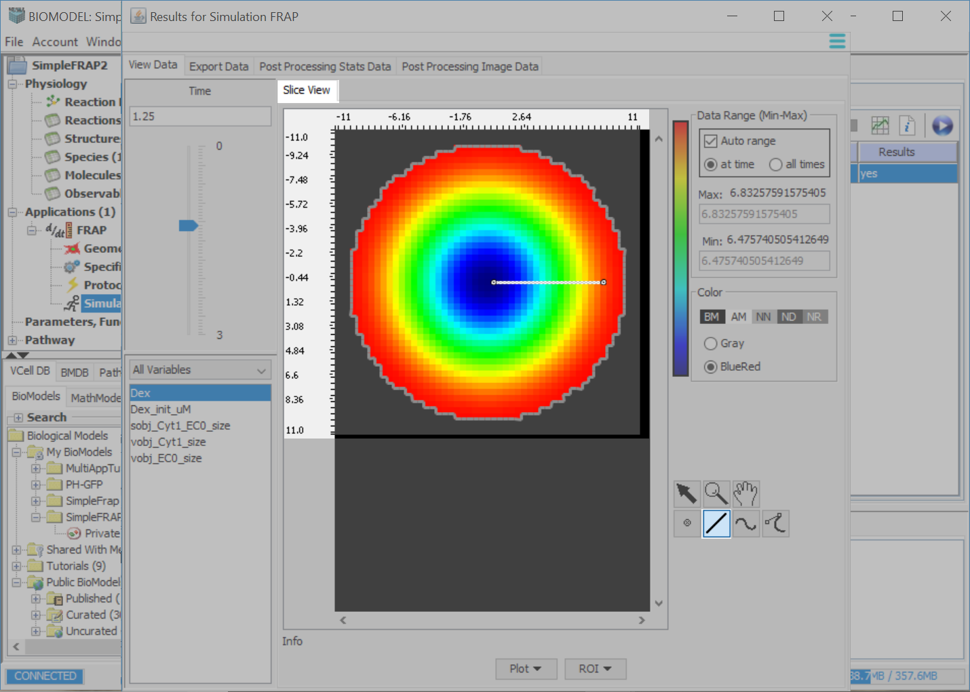
Select the line tool, click on a point within the data and click on another point. A line will form and connect the two points.
To view the data, click “Plot” > “Spatial”.

Slide 43
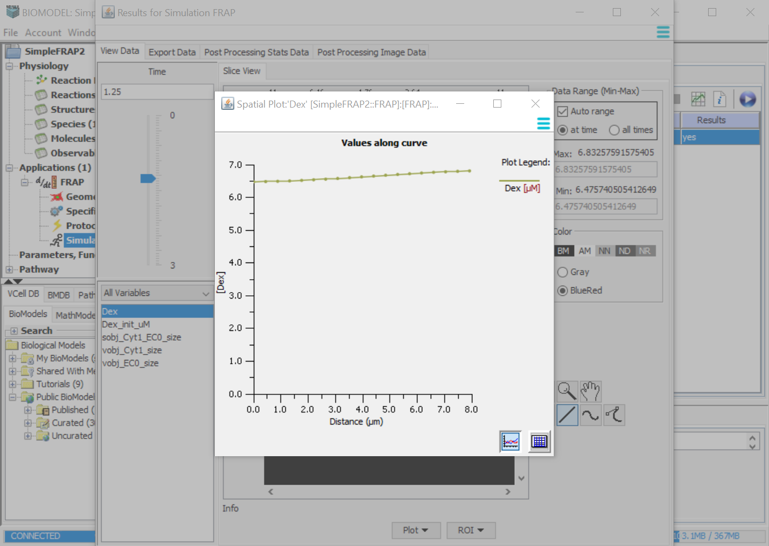
Click the spreadsheet icon to alternate to a spreadsheet view of the values on the graph.

Slide 44
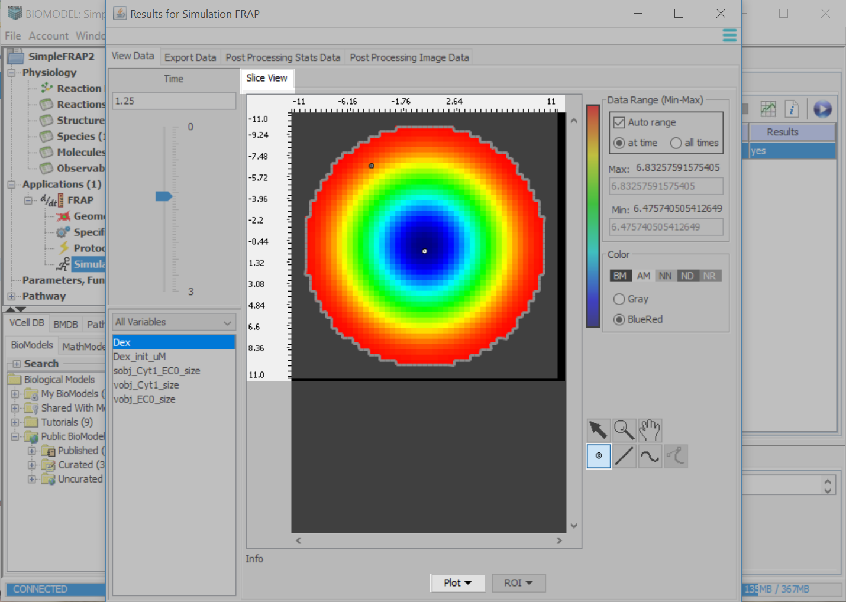
Select the Time Point tool and click on a point within the data. You can create one point or multiple points with this tool.
To view the data, click “Plot” > “Time”.

Slide 45
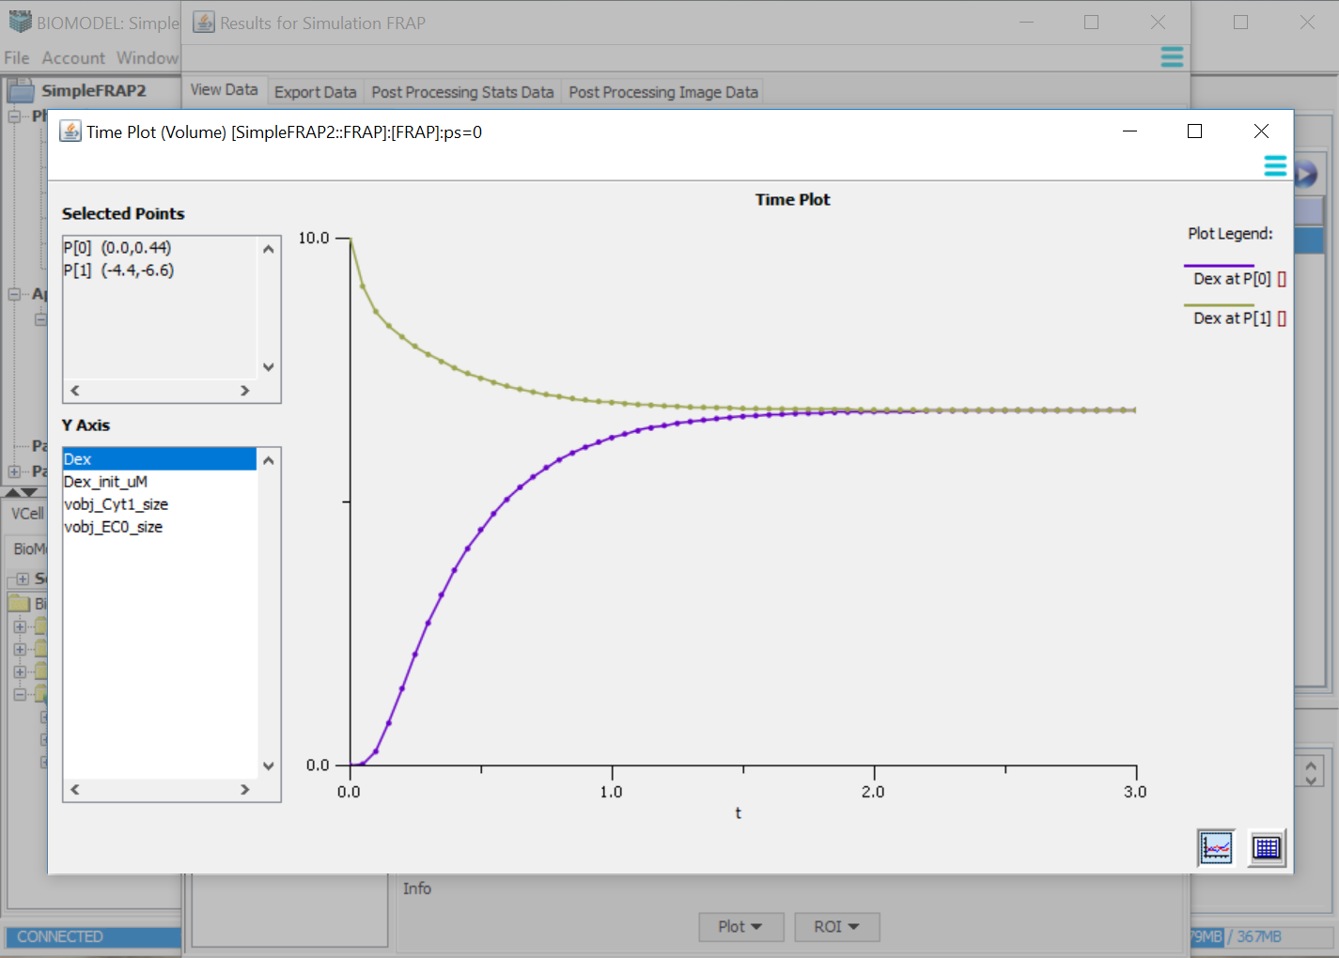
Click the spreadsheet icon to alternate to a spreadsheet view of the values on the graph.

